Slide 1
CSDS 451: Designing High Performant Systems for AI
Lecture 12
10/7/2025
Sanmukh Kuppannagari
sanmukh.kuppannagari@case.edu
https://sanmukh.research.st/
Case Western Reserve University

Slide 2
Outline
Pytorch Basics

Slide 3
Announcements
Midterm this Thursday - 10/9
Will cover topics till the previous lecture
I will upload WA1 and WA2 solutions by tonight

Slide 4
Outline
Pytorch Basics

Slide 5
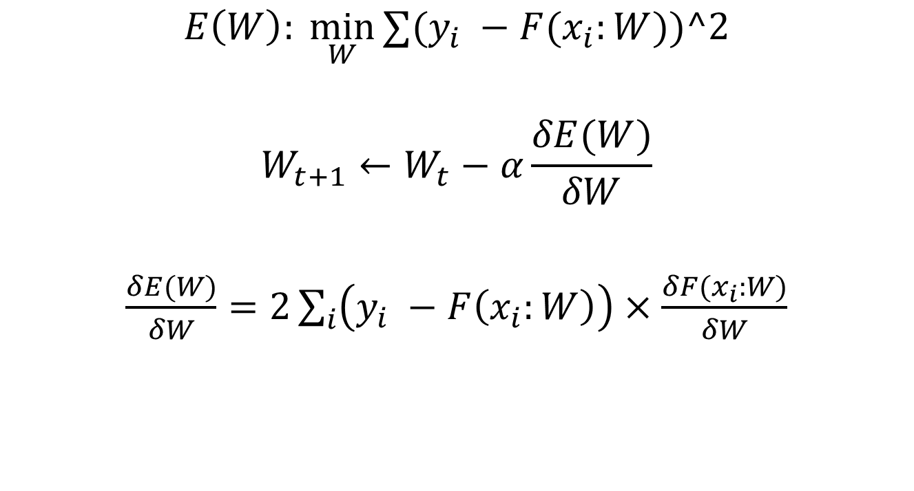
Training
$$E\left(W\right): \min_{W}{∑(y_{i} −{F(x}_{i}:W))^2}$$
$$W_{t+1}←W_{t}−α\frac{δE(W)}{δW}$$
$\frac{δE(W)}{δW}=2\sum_{i}{\left(y_{i} −F\left(x_{i}:W\right)\right)}×\frac{δF(x_{i}:W)}{δW}$
Iteratively
For all samples, in each iteration
Error

Slide 6
Training
$L$ layers in CNN
$$W_{1}, W_{2}, W_{3}, …, W_{L}$$
$$O_{1}, O_{2}, O_{3}, …, O_{L}$$
$$\frac{δF(x_{i}:W_{1:L})}{δW_{1}},\frac{δF(x_{i}:W_{1:L})}{δW_{2}},…,\frac{δF(x_{i}:W_{1:L})}{δW_{L}}$$
Weights (Filters/Kernels)
Output of layer
Compute these for all the samples
$$2∗Error ∗$$

Slide 7

CNN Training: Forward Propagation
$$I$$
For a single image

Slide 8


CNN Training: Forward Propagation
$$I$$
$$W_{1}$$
$$O_{1}$$
For a single image

Slide 9


CNN Training: Forward Propagation
$$I$$
$$W_{1}$$
$$O_{1}$$
$$W_{2}$$
$$O_{2}$$
For a single image

Slide 10


CNN Training: Forward Propagation
$$I$$
$$W_{1}$$
$$O_{1}$$
$$W_{2}$$
$$O_{2}$$
…
$$W_{L}$$
$$O_{L}$$
For a single image

Slide 11


CNN Training: Error Calculation
$$O_{L}$$
$$E(W)$$
$$y$$
For a single image

Slide 12
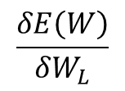
CNN Training: Backward Propagation
$$W_{L}$$
$$O_{L}$$
$$E(W)$$
$$y$$
$$\frac{δE\left(W\right)}{δW_{L}}$$
For a single image

Slide 13
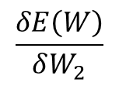
CNN Training: Backward Propagation
$$W_{2}$$
$$O_{2}$$
…
$$W_{L}$$
$$O_{L}$$
$$E(W)$$
$$y$$
$$\frac{δE\left(W\right)}{δW_{2}}$$
$$\frac{δE\left(W\right)}{δW_{L}}$$
For a single image

Slide 14
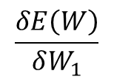
CNN Training: Backward Propagation
$$W_{1}$$
$$O_{1}$$
$$W_{2}$$
$$O_{2}$$
…
$$W_{L}$$
$$O_{L}$$
$$E(W)$$
$$y$$
$$\frac{δE\left(W\right)}{δW_{1}}$$
$$\frac{δE\left(W\right)}{δW_{2}}$$
$$\frac{δE\left(W\right)}{δW_{L}}$$
For a single image

Slide 15
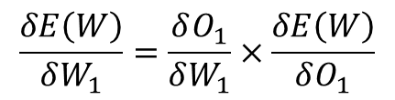
CNN Training: Backward Propagation
$$W_{1}$$
$$O_{1}$$
$$W_{2}$$
$$O_{2}$$
…
$$W_{L}$$
$$O_{L}$$
$$E(W)$$
$$y$$
$$\frac{δE\left(W\right)}{δW_{1}}=\frac{δO_{1}}{δW_{1}}×\frac{δE\left(W\right)}{δO_{1}}$$
For a single image

Slide 16
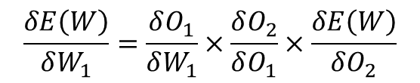
CNN Training: Backward Propagation
$$W_{1}$$
$$O_{1}$$
$$W_{2}$$
$$O_{2}$$
…
$$W_{L}$$
$$O_{L}$$
$$E(W)$$
$$y$$
$$\frac{δE\left(W\right)}{δW_{1}}=\frac{δO_{1}}{δW_{1}}×\frac{δO_{2}}{δO_{1}}×\frac{δE\left(W\right)}{δO_{2}}$$
For a single image

Slide 17
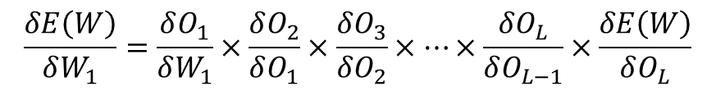
CNN Training: Backward Propagation
$$W_{1}$$
$$O_{1}$$
$$W_{2}$$
$$O_{2}$$
…
$$W_{L}$$
$$O_{L}$$
$$E(W)$$
$$y$$
$$\frac{δE\left(W\right)}{δW_{1}}=\frac{δO_{1}}{δW_{1}}×\frac{δO_{2}}{δO_{1}}×\frac{δO_{3}}{δO_{2}}×…×\frac{δO_{L}}{δO_{L−1}}×\frac{δE\left(W\right)}{δO_{L}}$$
For a single image

Slide 18
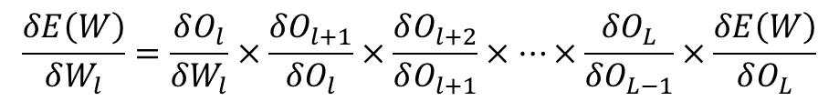
Training
$$E\left(W\right): \min_{W}{∑(y_{i} −{F(x}_{i}:W))^2}$$
$$W_{t+1}←W_{t}−α\frac{δE(W)}{δW}$$
$\frac{δE(W)}{δW}=2∑\left(y_{i} −F\left(x_{i}:W\right)\right)×\frac{δF(x_{i}:W)}{δW}$
Iteratively
For all samples, in each iteration
Error
For multiple images in a batch: Simply sum up the gradients
$$\frac{δE\left(W\right)}{δW_{l}}=\frac{δO_{l}}{δW_{l}}×\frac{δO_{l+1}}{δO_{l}}×\frac{δO_{l+2}}{δO_{l+1}}×…×\frac{δO_{L}}{δO_{L−1}}×\frac{δE\left(W\right)}{δO_{L}}$$

Slide 19
Training a Machine Learning Model
Partition dataset into batches
Epoch: Until all batches are covered
Read a batch from memory
iteration
Forward Propagation
Error Calculation
Backward Propagation

Slide 20

Pytorch
Python wrapper for Torch library
Open source library for working with tensors
Great accelerator support.
Automatically links to device specific accelerated libraries such as cuDNN, hipBLAS.
Abstracts away the hardware/system complexity of building and training AI/ML models

Slide 21
Pytorch - Workflows
Inference: Use a pretrained model to perform inference on data
Training: Train a model using a dataset
Fine-tune a pre-trained model using a dataset
Train a new custom model from scratch

Slide 22
Pytorch - Inference
Pre-trained models available at pytorch
Vision Models - https://docs.pytorch.org/vision/stable/models.html
Transformer Models (for NLP) - https://docs.pytorch.org/text/stable/models.html

Slide 23
Pytorch - Inference
Download the model weights from pytorch ‘cloud’
Apply them to a model architecture
Transform the image on which you need to perform inference based on the requirements of the model
Perform inference using the model

Slide 24
Pytorch - Inference
Download the model weights from pytorch ‘cloud’
Apply them to a model architecture
Transform the image on which you need to perform inference based on the requirements of the model
Perform inference using the model

Slide 25
Pytorch - Inference
from torchvision.io import decode_image
from torchvision.models import resnet50, ResNet50_Weights
img = decode_image("test/assets/encode_jpeg/grace_hopper_517x606.jpg")
# Step 1: Initialize model with the best available weights
weights = ResNet50_Weights.DEFAULT
model = resnet50(weights=weights)
model.eval()
# Step 2: Initialize the inference transforms
preprocess = weights.transforms()
# Step 3: Apply inference preprocessing transforms
batch = preprocess(img).unsqueeze(0)
# Step 4: Use the model and print the predicted category
prediction = model(batch).squeeze(0).softmax(0)
class_id = prediction.argmax().item()
score = prediction[class_id].item()
category_name = weights.meta["categories"][class_id]
print(f"{category_name}: {100 * score:.1f}%")

Slide 26
Pytorch - Inference
Download the model weights from pytorch ‘cloud’
Apply them to a model architecture
Transform the image on which you need to perform inference based on the requirements of the model
Perform inference using the model

Slide 27
Pytorch - Inference
from torchvision.io import decode_image
from torchvision.models import resnet50, ResNet50_Weights
img = decode_image("test/assets/encode_jpeg/grace_hopper_517x606.jpg")
# Step 1: Initialize model with the best available weights
weights = ResNet50_Weights.DEFAULT
model = resnet50(weights=weights)
model.eval()
# Step 2: Initialize the inference transforms
preprocess = weights.transforms()
# Step 3: Apply inference preprocessing transforms
batch = preprocess(img).unsqueeze(0)
# Step 4: Use the model and print the predicted category
prediction = model(batch).squeeze(0).softmax(0)
class_id = prediction.argmax().item()
score = prediction[class_id].item()
category_name = weights.meta["categories"][class_id]
print(f"{category_name}: {100 * score:.1f}%")
Set model’s model to evaluation – We are telling the model that this is not training to avoid some training specific operations

Slide 28
Pytorch - Inference
Download the model weights from pytorch ‘cloud’
Apply them to a model architecture
Transform the image on which you need to perform inference based on the requirements of the model
Perform inference using the model

Slide 29
Pytorch - Inference
from torchvision.io import decode_image
from torchvision.models import resnet50, ResNet50_Weights
img = decode_image("test/assets/encode_jpeg/grace_hopper_517x606.jpg")
# Step 1: Initialize model with the best available weights
weights = ResNet50_Weights.DEFAULT
model = resnet50(weights=weights)
model.eval()
# Step 2: Initialize the inference transforms
preprocess = weights.transforms()
# Step 3: Apply inference preprocessing transforms
batch = preprocess(img).unsqueeze(0)
# Step 4: Use the model and print the predicted category
prediction = model(batch).squeeze(0).softmax(0)
class_id = prediction.argmax().item()
score = prediction[class_id].item()
category_name = weights.meta["categories"][class_id]
print(f"{category_name}: {100 * score:.1f}%")
Transformations can be cropping or resizing the image so that it is similar in dimensions to what model is expecting

Slide 30
Pytorch - Inference
Download the model weights from pytorch ‘cloud’
Apply them to a model architecture
Transform the image on which you need to perform inference based on the requirements of the model
Perform inference using the model

Slide 31
Pytorch - Inference
from torchvision.io import decode_image
from torchvision.models import resnet50, ResNet50_Weights
img = decode_image("test/assets/encode_jpeg/grace_hopper_517x606.jpg")
# Step 1: Initialize model with the best available weights
weights = ResNet50_Weights.DEFAULT
model = resnet50(weights=weights)
model.eval()
# Step 2: Initialize the inference transforms
preprocess = weights.transforms()
# Step 3: Apply inference preprocessing transforms
batch = preprocess(img).unsqueeze(0)
# Step 4: Use the model and print the predicted category
prediction = model(batch).squeeze(0).softmax(0)
class_id = prediction.argmax().item()
score = prediction[class_id].item()
category_name = weights.meta["categories"][class_id]
print(f"{category_name}: {100 * score:.1f}%")
For a batch of images, the model produces the prediction output.

Slide 32
Pytorch – Training
Decide what dataset to use
Create a Dataloader object – responsible for creating batches
Define the model architecture
Choose a loss function
Training loop – actual testing occurs here
Testing – periodically test to ensure model training is proceeding on the right direction

Slide 33
Pytorch – Training
Datasets – List of common datasets are available on pytorch
Vision - https://docs.pytorch.org/vision/stable/datasets.html
Text - https://docs.pytorch.org/text/stable/datasets.html
You can also use your own custom dataset - https://docs.pytorch.org/tutorials/beginner/data_loading_tutorial.html

Slide 34
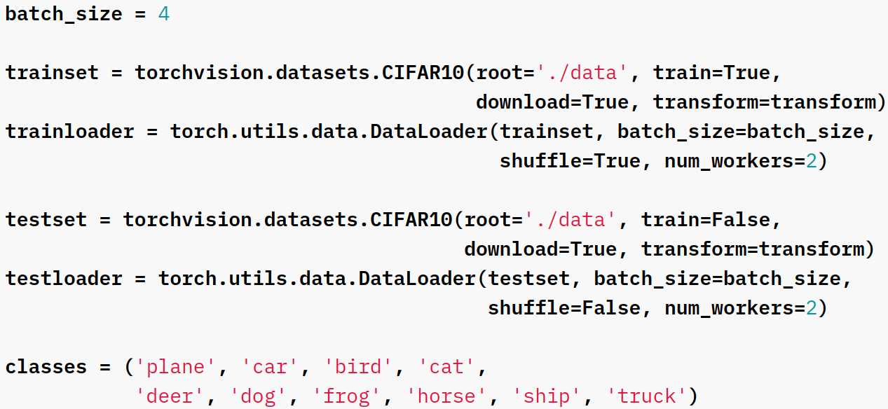
Pytorch – Training
Loading/Downloading a dataset from Pytorch
Train = True/False -> training/testing portion
Transform = Applies the transform that is needed for the model that you wish to use (such as resizing, cropping)

Slide 35
Pytorch – Training
Creating a DataLoader object
Enables accessing data in batches
Performs random shuffling to improve AI/ML convergence

Slide 36
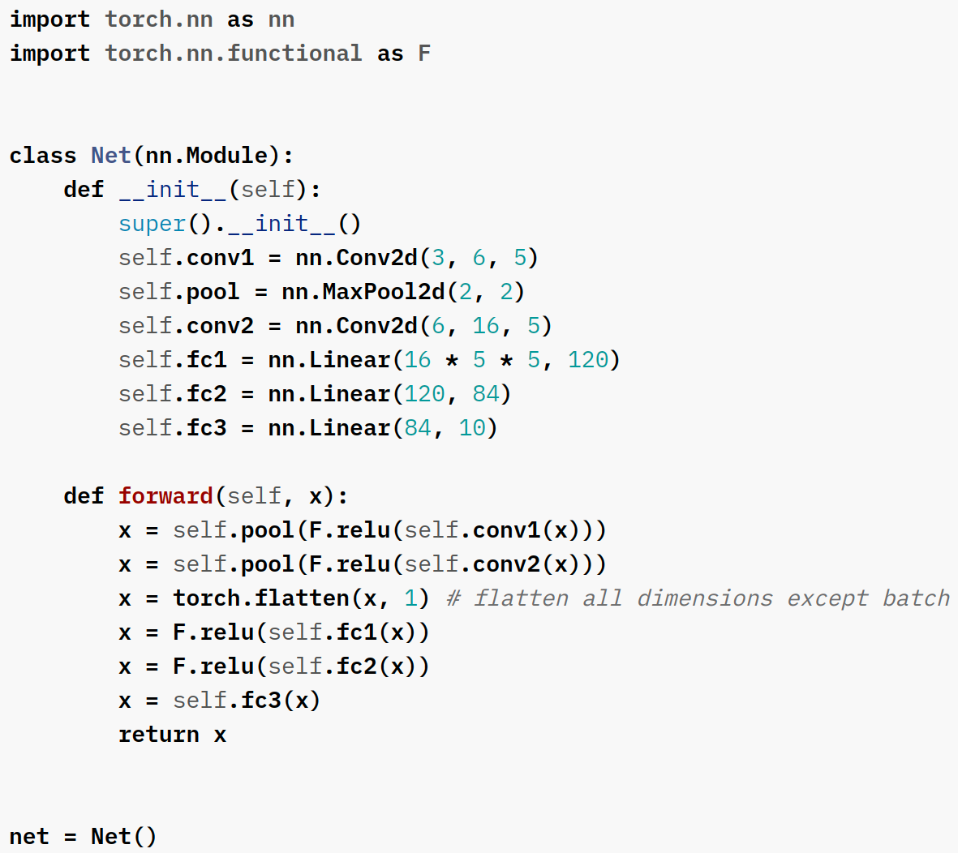
Pytorch – Training
Defining the model architecture
Layers (and structure) need to be outlined in the __init__ method.
Specific attributes can be passed in here.
Forward describes the data's movement through the model.
Activation functions tend to be applied here.
Create an instance of the model.

Slide 37
Pytorch – Training
The __init__ method is analogous to defining types of certain vertices within a task graph.
These are layers, but they also perform operations.
However, there is nothing specifying quantity or order (how data flows through these).
Conv1
Pool
Conv2
FC1
FC2
FC3

Slide 38
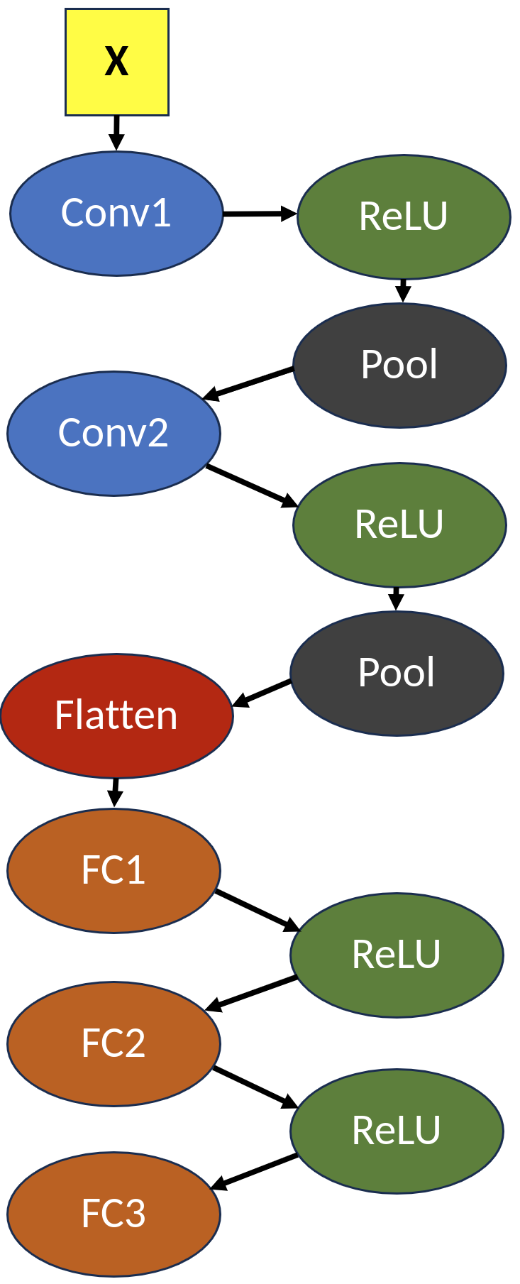
Pytorch – Training
forward() specifies connectivity and data flow
During inference, when we call model(img), the forward function gets called

Slide 39
Pytorch – Training
In backward propagation, the gradients flow in the reverse direction of the connectivity
Do we explicitly define the backward() function?
No, Autograd functionality takes care of this in most circumstances

Slide 40
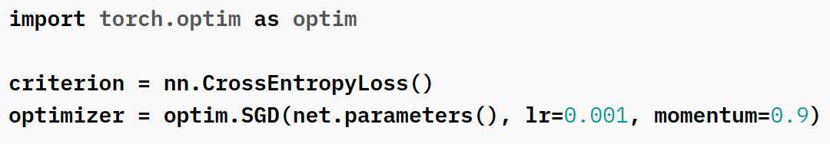
Pytorch – Training
Choosing a loss function
Appropriate loss function for your task, you can also build custom loss functions
We also need to choose an optimizer
It applies the weight updates based on the gradients calculated in backpropagation
SGD, ADAM are popular optimizers

Slide 41
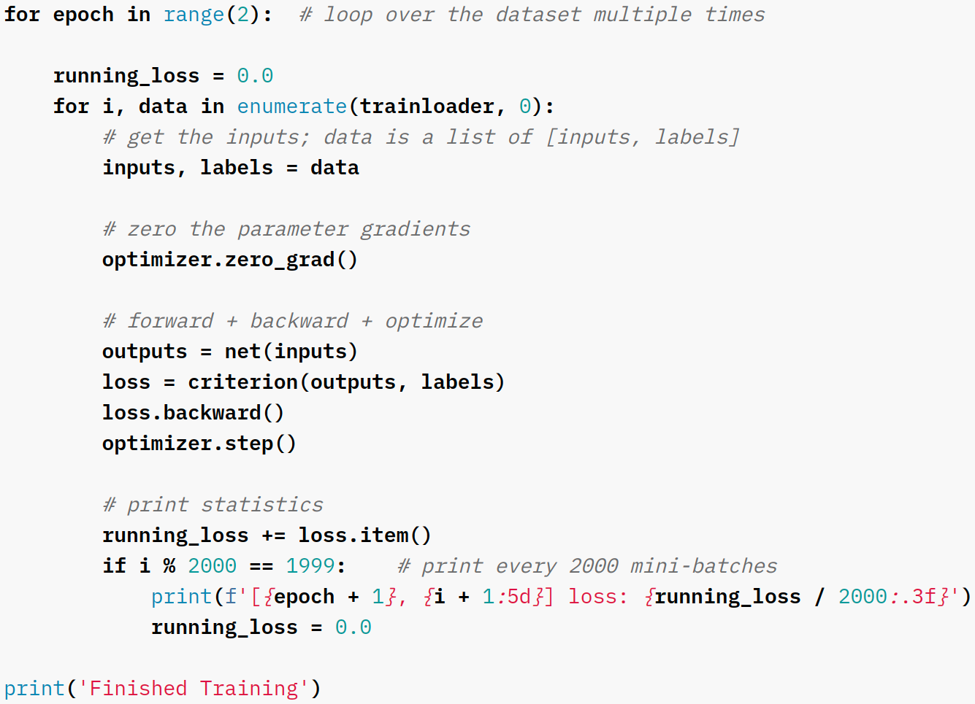
Pytorch – Training
Training Loop
Epoch: Go over the entire dataset in batches to perform forward and backward propagation
Stop training after a set number of epochs (or some other convergence criteria)

Slide 42
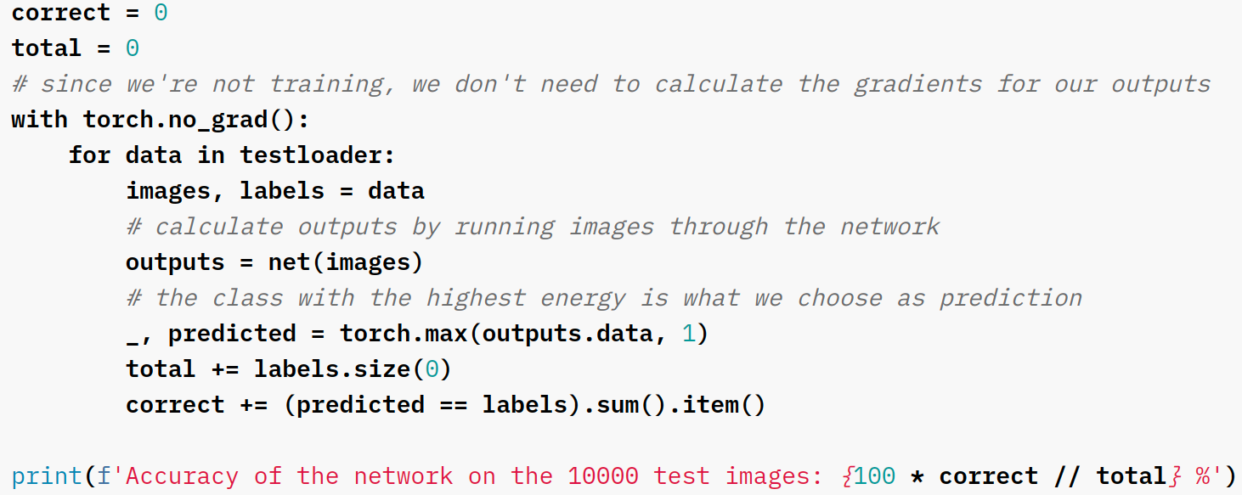
Pytorch – Training
Testing Loop
Test the performance of the model in an unknown data

Slide 43

Pytorch – Execution on Accelerators
PyTorch defaults to the CPU, even if there are other resources available.
Specifying a GPU is easy.
Indicate what device to use:
Send your model to the device:
Send your data to the device:

Slide 44
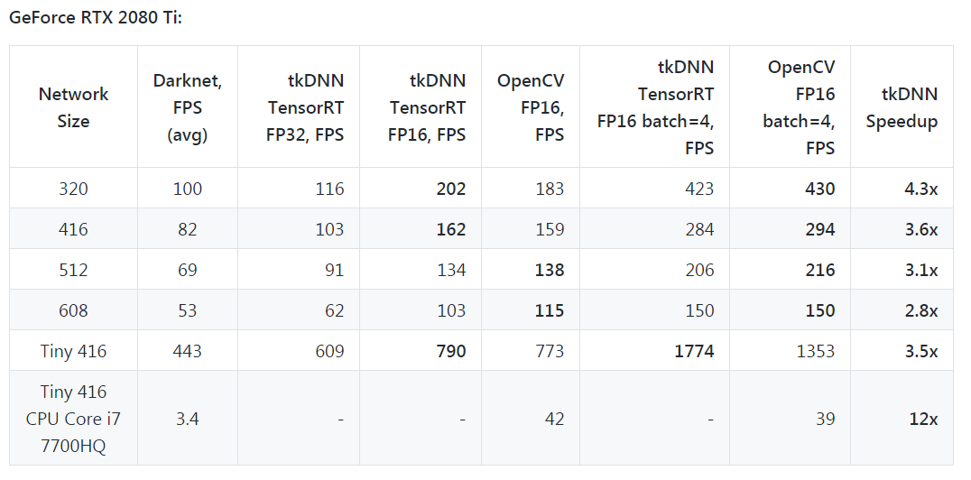
Pytorch – Execution on Accelerators
For simple networks, the speedup may not be noticeable.
However, on larger ones it can be quite substantial.
Table is from the DarkNet repo (YOLO).
tkDNN is a neural network library built using cuDNN and tensorRT.

Slide 45
Next Class
10/9 Midterm
Best of luck!
10/14 Lecture 14
Pytorch-Lightning

Slide 46
Thank You
Questions?
Email: sanmukh.kuppannagari@case.edu

